Slide 1
M.Tech DSE Machine Learning (DSECL ZG565 )
Dr. Monali Mavani

Slide 2
Part – I Agenda
Bayesian learning
Bayes Theorem (T1 book by Tom Mitchell - 6.2)
MAP Hypothesis (T1 book by Tom Mitchell - 6.3)
MLE Hypothesis (T1 book by Tom Mitchell - 6.4)

Slide 3
Probability Basics
Prior, conditional and joint probability
Prior probability:
Conditional probability:
Joint probability:
Relationship:
Independence:

Slide 4
Joint Probability Distributions
Joint Probability Distributions of
Data Set, D
Data Set, D
X1 | X2 | Label
F | F | F
T | F | T
F | T | T
T | T | T
F | T | T
F | F | F
T | T | T
F | F | F
X1 | X2 | P(X1,X2)
F | F | 3/8
F | T | 2/8
T | F | 1/8
T | T | 1/8

Slide 5
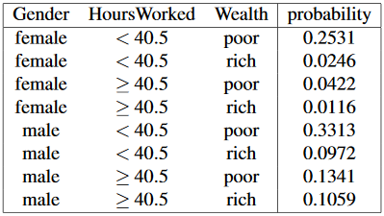
Using the Joint Distribution
One you have the JD you can ask for the probability of any logical expression involving these variables

Slide 6
Using the Joint Distribution
P(Poor Male) = 0.4654

Slide 7
Using the Joint Distribution
P(Poor) = 0.7604

Slide 8
Using the Joint Distribution
P(Male | Poor) = 0.4654 / 0.7604 = 0.612

Slide 9
Learning the joint distribution
For n binary variable the number of rows required in table ?
If n = 100 ?
Which is greater than 10^{30.}
Number of people on earth are 10¹⁰
Therefore most of the rows would have zero training examples.
To successfully address the issue of learning probabilities from available training data, we must
be smart about how we estimate probability parameters from available data
be smart about how we represent joint probability distributions

Slide 10
Estimating Probabilities
There are two intuitive algorithms to estimate probabilities.
MLE
MAP
Example: Let X be a binary random variable which represents a coin.
X= 1; if coin flips to heads
X= 0; if coin flips to tails

Slide 11
Example
Task is to estimate the probability P(X=1).
Let Ө refers to the true probability of head (P(X=1) = Ө )
We use Ӫ to refer to our learned estimate of this true Ө.
To estimate the probability we gathered data by flipping the coin n times
n = α₁ + α₀ ; where α₁ = number of heads
and α₀ = number of tails.

Slide 12
Estimating Probabilities: First Algorithm
As we have seen most intuitive estimate is
Ӫ = α₁ / (α₁ + α₀ )
we flip a coin 50 time and we get 24 head out of 50 flips then
Ӫ = 24 / (24 + 26 ) = 0.48 ≈ 0.5
we flip coin 3 time and we get head once then
Ӫ = 1 / (1 + 2 ) ≈ 0.33
Though, if we have some prior knowledge about coin,
for example, if the coin is government minted, then we might believe that Ӫ much closer to 0.5 that 0.33

Slide 13
Estimating Probabilities: Second Algorithm
Second Algorithm allow us to incorporate our prior knowledge about coins by adding any number of imaginary coin flips resulting in heads and tails.
Let assume, γ₁ denotes imaginary heads
γ₀ denotes imaginary tails
Considering this prior knowledge, now the Ӫ can be estimated as follows:
Ӫ = α₁ + γ₁ / (α₁ + γ₁ + α₀ + γ₀)

Slide 14
Estimating Probabilities: Second Algorithm
we have reason to assume that Ө is 0.7 we can put:
γ₁ = 7 and γ₀ = 3
if we are highly certain about our prior belief that Ө is 0.7
γ₁ = 700 and γ₀ = 300
First algorithm is a special case of second algorithm.
(γ₁ = 0 and γ₀ = 0)
As observed data grows towards infinity, the influence of our imaginary data goes to zero.

Slide 15
Estimating Probabilities
MLE Vs MAP
Both algorithms exemplify the two most widely used approaches to machine learning of probabilistic models from training data.
Algorithm 1 follows a principle called Maximum Likelihood Estimation (MLE), in which we seek an estimate of Ө that maximizes the probability of the observed data.
Algorithm 2 follows a different principle called Maximum a Posteriori (MAP) estimation, in which we seek the estimate of Ө that is most probable, given the observed data, plus background assumptions about its value

Slide 16
Why Do We Care?
In real world, don’t know “true” parameters
But, we do get to observe data
o E.g., number of times coin comes up heads, lifetimes of disk drives produced, number of visitors to web site per day, etc.
Need to estimate model parameters from data
Estimate of parameters allows:
Better understanding of process producing data
Future predictions based on model
Simulation of processes

Slide 17
Parameters and Parametric Models
Usually refer to parameters of distribution as θ
Note that θ that can be a vector of parameters
© Stanford 2016 - Chris Piech

Slide 18
Likelihood
Assumption : data are identically distributed (same probability mass function (discrete RV) or the same probability density function ( continuous RV)
f(X | θ) : likelihood of different values of X depends on the values of our parameters
discrete distributions: likelihood is a synonym for the joint probability of your data.
continuous distribution: likelihood refers to the joint probability density of your data.

Slide 19
Likelihood
Likelihood: Since each data point is independent, the likelihood of all of our data is the product of the likelihood of each data point. Mathematically,
Intuitively: what is probability of observed data using
density function f(Xi | θ), for some choice of θ
Log Likelihood

Slide 20
Maximum Likelihood Estimation (MLE)
MLE: to chose values of our parameters (θ) that maximizes the likelihood function i.e the best choice of values for our parameters. Formally,
If the sample is large, MLE will yield an excellent estimator of θ.
MLE answers the question: For which parameter value does the observed data have the biggest probability?

Slide 21
MLE
If X is discrete,
If X is continuous,
Note: In the continuous case, we have to multiply densities, because the probability of seeing a particular value with a continuous random variable is always 0. We can do this because the density preserves relative probabilities;

Slide 22
Machine Learning:
Learn parameters (mostly with MLE) For probabilistic models.

Slide 23
maximum a posteriori - MAP
what is our distribution over X?
Frequentist
Play game infinitely many times and see how often different values come up.
Problem: I only allow you to play the game once
Bayesian probability
Have prior belief of distribution for X (or anything for that matter)
Prior belief is a subjective probability
By extension, all probabilities are subjective

Slide 24
maximum a posteriori - MAP

Slide 25
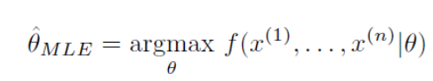
MLE vs MAP
MAP : chose the value for the parameters that is the most likely given the data.
MLE: chooses the value of parameters that makes the data most likely. Goal is to find the parameter θ that maximizes the likelihood (probability) of seeing the data,
IID random variables X1; ….. ;Xn:

Slide 26
MLE vs MAP
MLE
we assumed θ was fixed but unknown.
Frequentist framework
we only estimate our parameter based on data alone, and is not a random variable.
MAP
Bayesian framework, meaning that our unknown parameter is a random variable

Slide 27
Machine Learning as Bayesian Learning

Slide 28
function approximation?
instead of F: X ->Y,
learn P(Y|X)

Slide 29
Probabilistic view of function
Interested in learning target function from given data set D
f : X → Y
We can more generally learn probabilistic function with uncertain outcomes (to compensate real world noise) and that incorporate prior knowledge to guide learning.
P(Y|X)
Two most common approach for estimating P(Y|X) is
Maximum Likelihood (MLE)
Maximum a posteriori estimation (MAP)

Slide 30
MAP Hypothesis
Machine learning is interested in the best hypothesis h from some space H, given observed training data D
best hypothesis ≈ most probable hypothesis
Bayes Theorem provides a direct method of calculating the probability of such a hypothesis based on its prior probability, the probabilities of observing various data given the hypothesis, and the observed data itself

Slide 31
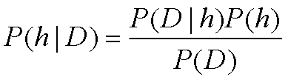
Bayes Theorem -Recall
P(h) prior probability of h, reflects any background knowledge about the chance that h is correct.
P(D) prior probability of D, probability that D will be observed
P(D|h) probability of observing D given a world in which h holds
P(h|D) posterior probability of h, reflects confidence that h holds after D has been observed
Applying Bayes rule to infer a hidden quantity from one or more observations is called Bayesian inference/posterior inference. / probabilistic inference
Bayes Theorem:

Slide 32
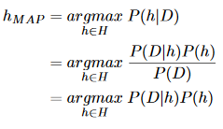
MAP Hypothesis
in many learning scenarios, the learner considers some set of candidate hypotheses H and is interested in finding the most probable hypothesis h ∈ H given the observing training data D
any maximally probable hypothesis is called maximum a posteriori (MAP) hypotheses
Note that P(D) can be dropped, because it is constant independent of h

Slide 33
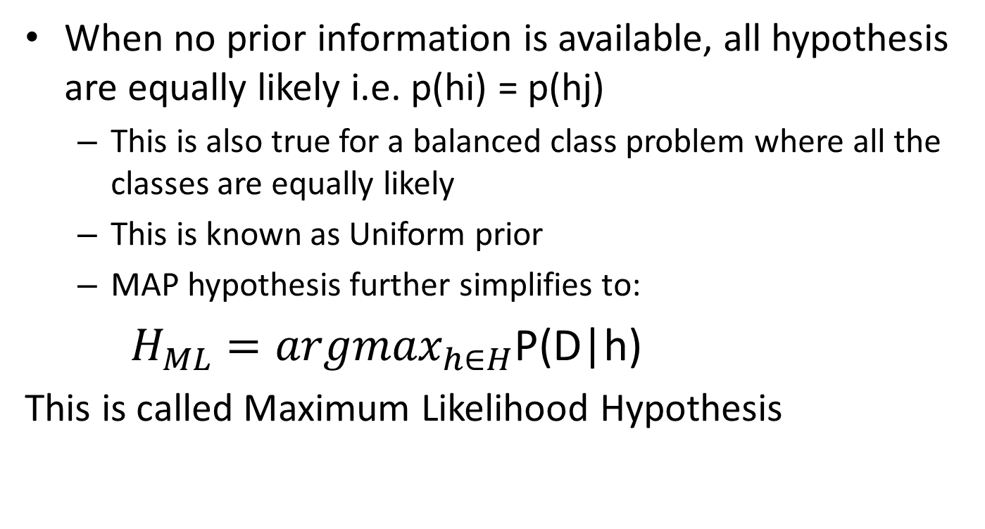
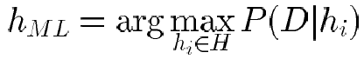
ML Hypothesis
Note that in this case P(h) can be dropped, because it is equal for every h ∈ H

Slide 34
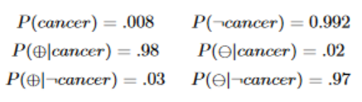
Example
Consider a medical diagnosis problem in which there are two alternative hypothesis
The patient has particular form of cancer
The patient does not
The available data is from particular laboratory with two possible outcomes: ⊕ (positive) and (negative )
Suppose a new patient is observed for whom the lab returns a positive (⊕ ) result
Should we diagnosis the patient as having a cancer or not?

Slide 36
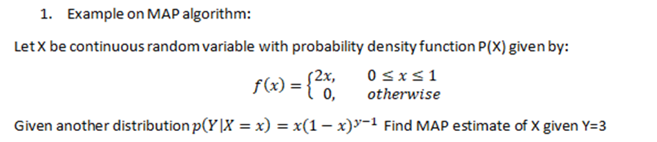
Examples on h_MAP and h_MLE

Slide 38
ML setting - Bayesian Analysis
start with some belief about the system, called a prior.
Then we obtain some data and use it to update our belief.
The outcome is called a posterior.
Should we obtain even more data, the old posterior becomes a new prior and the cycle repeats.

Slide 39
ML Setting - Bayesian Analysis
P(h | D) a posterior determines the class label
It’s a probability distribution over model parameters obtained from prior beliefs and data.
When one uses likelihood to get point estimates of model parameters, it’s called Maximum Likelihood estimation or MLE.
If one also takes the prior into account, then it’s maximum a posteriori estimation (MAP).
MLE and MAP are the same if the prior is uniform
This forms the basis for Naïve Bayes classifier

Slide 40
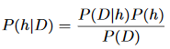
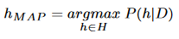
Bayes theorem and Concept Learning
What is the relationship between Bayes theorem and Concept Learning.
It can be used for designing a straight forward learning algorithm.
Brute-Force MAP Learning algorithm
1. For each hypothesis h ∈ H, calculate the posterior probability
2. Output hypothesis with the highest posterior probability

Slide 41
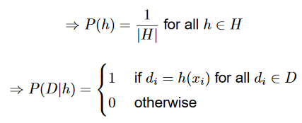
Brute-Force MAP Learning algorithm
in order to specify a learning problem for the algorithm, values for P(h) and P(D|h) must be specified.
Assumptions
Training data, D is noise free (i.e. d_{i} = c(x_{i}))
Target concept c is contained in H i.e.
No reason to believe that any hypothesis is more probable than any other

Slide 42
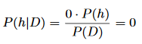
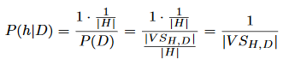
Brute-Force MAP Learning algorithm
h is inconsistent with the training data D
H is consistent with training data D
The above analysis implies that under our choice for P(h) and P(Dlh), every consistent hypothesis has posterior probability
every inconsistent hypothesis has posterior probability 0.
Every consistent hypothesis is, therefore, a MAP hypothesis.

Slide 43
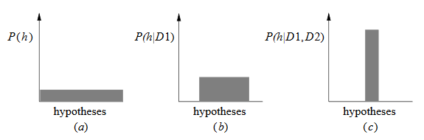
MAP Hypotheses and consistent learnrers
Evolution of probabilities:
all hypotheses have the same probability
+ (c) as training data accumulates, the posterior probability of inconsistent hypotheses becomes zero while the total probability summing to 1 is shared equally among the remaining consistent hypotheses

Slide 44
Bayesian analysis can sometimes be used to
show that a particular learning algorithm outputs MAP hypotheses even though it
may not explicitly use Bayes rule or calculate probabilities in any form.

Slide 45
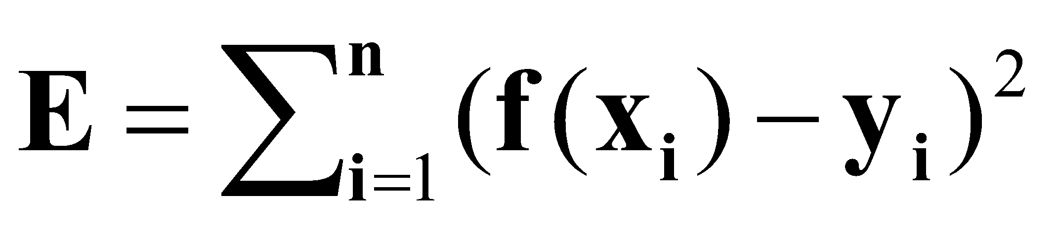
Evaluating Performance
If y is continuous:
Sum-of-Squared-Differences (SSD) error between predicted and true y:

Slide 46
Bayesian justification to Least-Squared Error
Problem: learning continuous-valued target functions
Minimizing the sum of squared errors
E.g linear regression, NN, Polynomial curve fitting
under certain assumptions any learning algorithm that minimizes the squared error between the output hypothesis and the training data, will output a ML hypothesis

Slide 47
Learning A Real Valued Function
Problem setting:
(∀h ∈ H) [ h : X →ℜ ] and training examples of the form <x_{i ,} d_{i} >
unknown target function f : X →ℜ
Training examples <x_{i}, d_{i}>, where d_{i} is noisy training value
d_{i} = f(x_{i}) + e_{i}
e_{i} is random variable (noise) drawn independently for each x_{i} according to some Gaussian distribution with mean=0

Slide 48
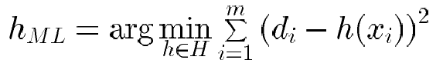
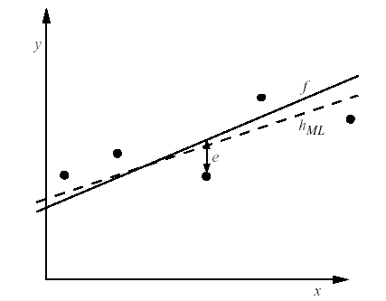
Learning A Real Valued Function:
CASE of Linear Regression loss
Then the maximum likelihood hypothesis h_{ML} is the one that minimizes the sum of squared errors:

Slide 49
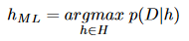
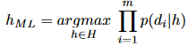
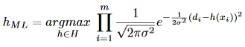
Learning A Real Valued Function:
CASE of Linear Regression loss
The training examples are assumed to be mutually independent given h
Given the noise e_{i} obeys a Normal distribution with zero mean and unknown variance σ , each d_{i} must also obey a Normal distribution around the true target value f(x_{i})
Because we are writing the expression for d_{i} given that h is correct description of target function f. We will also substitute, μ = f(x_{i}) = h(x_{i}). Hence:

Slide 51
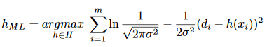
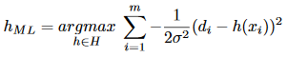
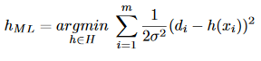
Maximum Likelihood and Least-Squared Error
It is common to maximize the less complicated logarithm, which is justified because of the monotonicity of this function
The first term in this expression is a constant independent of h and can therefore be discarded
Maximizing this negative term is equivalent to minimizing the corresponding positive term

Slide 52
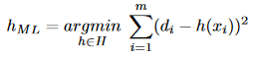
Maximum Likelihood and Least-Squared Error
Finally, all constants independent of h can be discarded
is one that minimizes the sum of the squared error

Slide 53
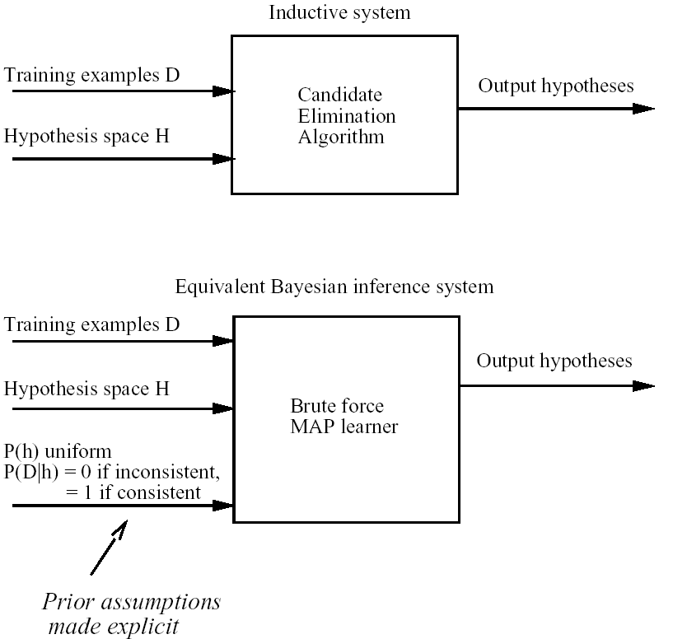
Characterizing Learning Algorithms by Equivalent MAP Learners

Slide 54
Some Additional References
https://web.stanford.edu/class/archive/cs/cs109/cs109.1166//handouts/overview.html
https://www.cs.cmu.edu/~ninamf/courses/601sp15/lectures.shtml

